Slide 1
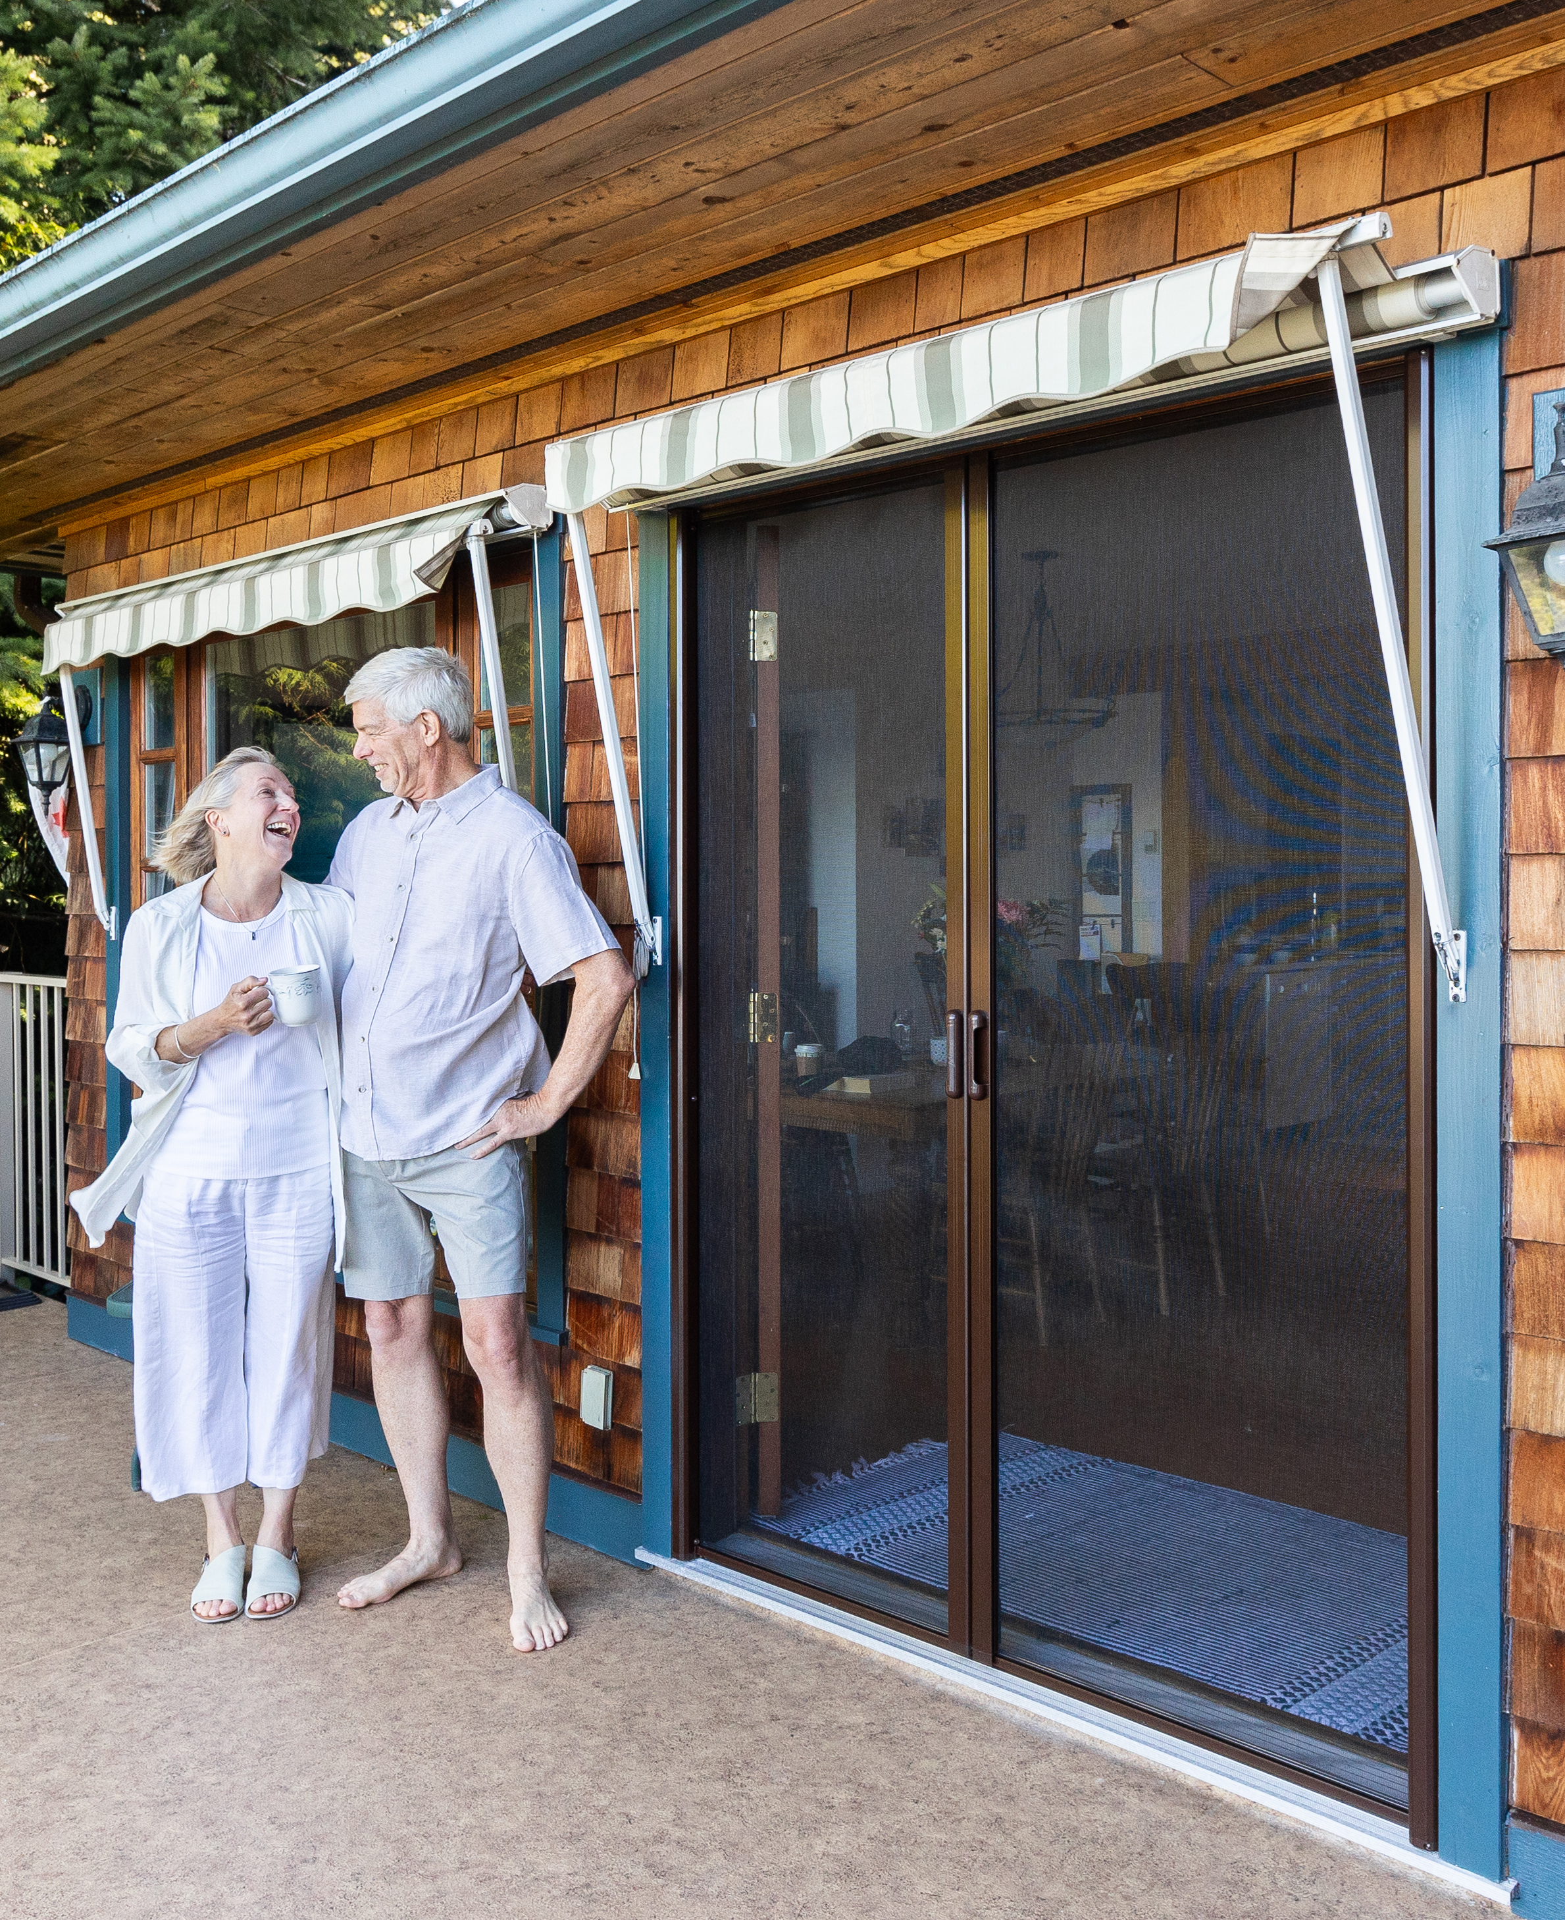
1750
Webinar
(855) 488 7655
miragescreensystems.com
T
W

Slide 2
Today’s agenda
01.
About Mirage
06.
Why Mirage?
02.
Meet the Team
07.
Questions?
03.
Why retractable?
04.
Product basics
05.
Parts of the screen

Slide 4
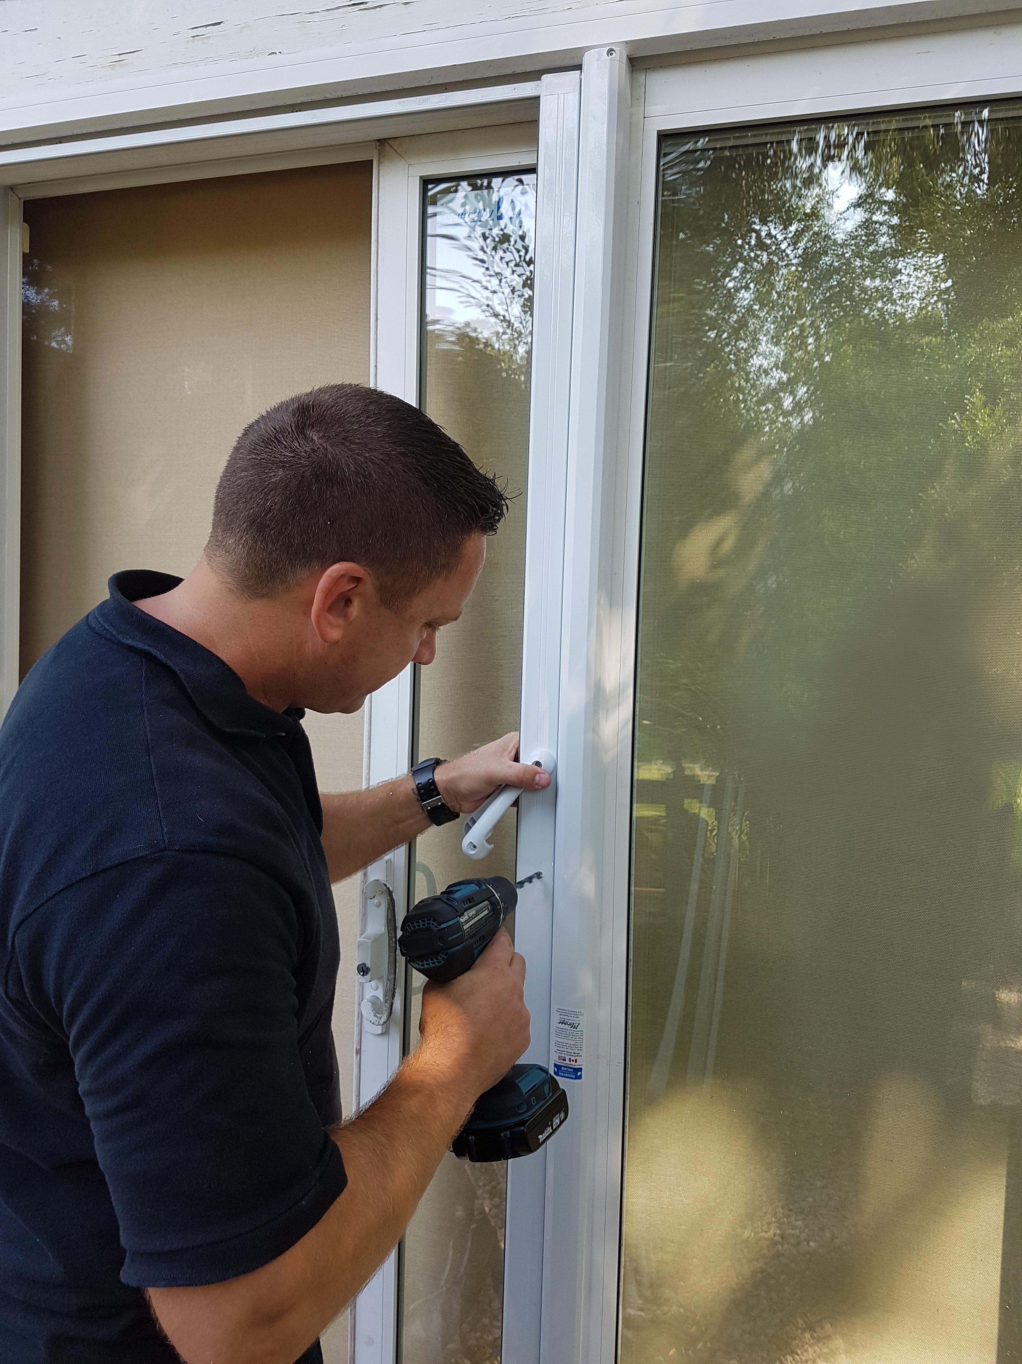
Service and Support
Webstore​
- Easy ordering 24/7​
- Online support materials​
Marketing support​
- Free marketing materials​
- Web and digital marketing expertise​
- Google Ads Cost sharing​
- Social Media Posting
Superior Customer Service Support
Competitive pricing…​

Slide 5
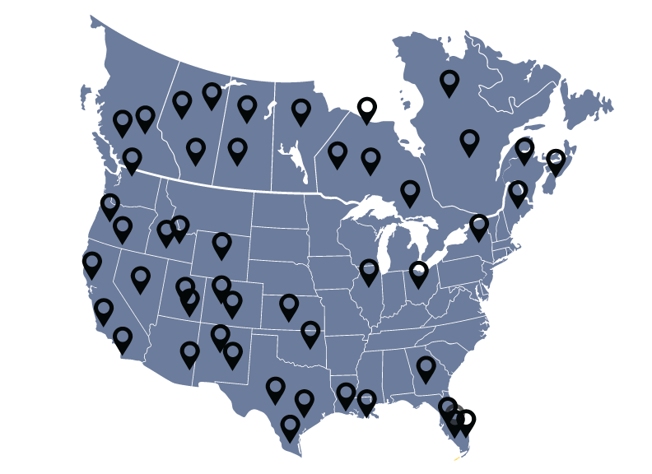
About Mirage
Established in 1997 Mirage is a North American manufacturer of retractable and motorized screens. Now offering 3 products.
Core Values
Collaboration and support are values that distinguish us in our market
Over 450 Dealers
across North America
Locations
Vancouver, BC
Kitchener, ON
Ocala, FL

Slide 6
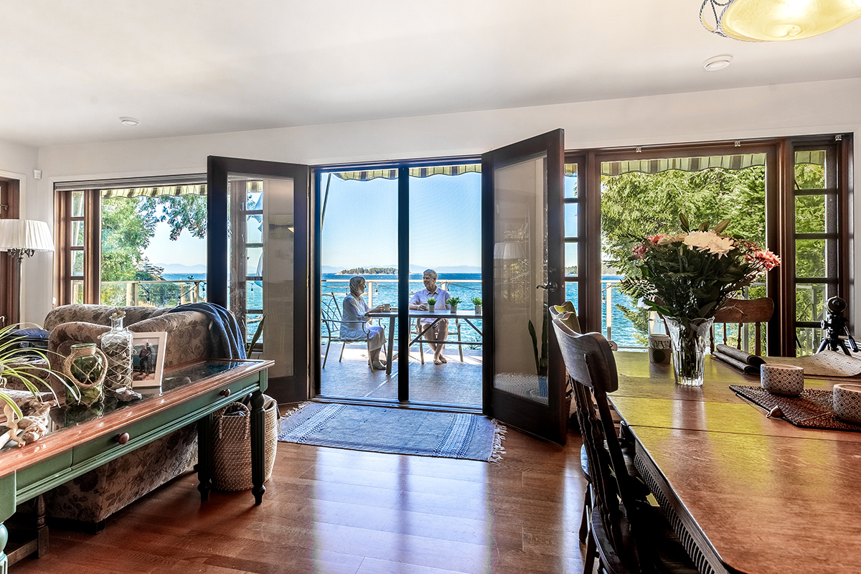
For the consumers
WHY retractable Screens?
For your business
Discreet/appearance
Out of the way when not needed
Good margins
Diversification of product offering
Variety of activity in your workday

Slide 7
Product Basics
Sizes
3 heights 83 ¼” 98” 108”
3 widths 45” 55” 64”
Can order standard heights or cut to size
Mesh Types
18 X 14 Stiff fiberglass (standard)
18 X 16 Elite fiberglass (for 55” and 64”widths)
17 X 17 Super screen polyester (pet mesh)
20 X 20 “No-see-um” mesh
Colors
8 Standard colors
18 Diamond series colors
Custom colors available (supply RAL#)
Ex Pebble grey
Linen cream
Midnight black
Polar white
Rideau brown
Sandal-
wood
Slate grey
Tudor brown

Slide 8
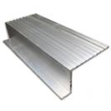
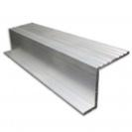
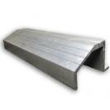
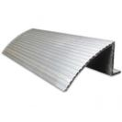
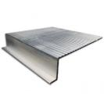
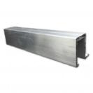
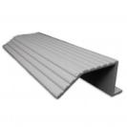
Product basics (2/2)
Sill adapters
Used to provide a surface on which to mount the bottom track
Seven shapes
Sill adapter used depends on factors such as
- Slope of threshold
- Depth of door jamb
- Mounting locations of housing
Sill adapter - Interior
Sill adapter - Exterior
Sill adapter –
Top
Sill adapter –
Ramp
Sill adapter –
5 inch
Sill adapter –
Trim
Sill adapter –
Threshold

Slide 9
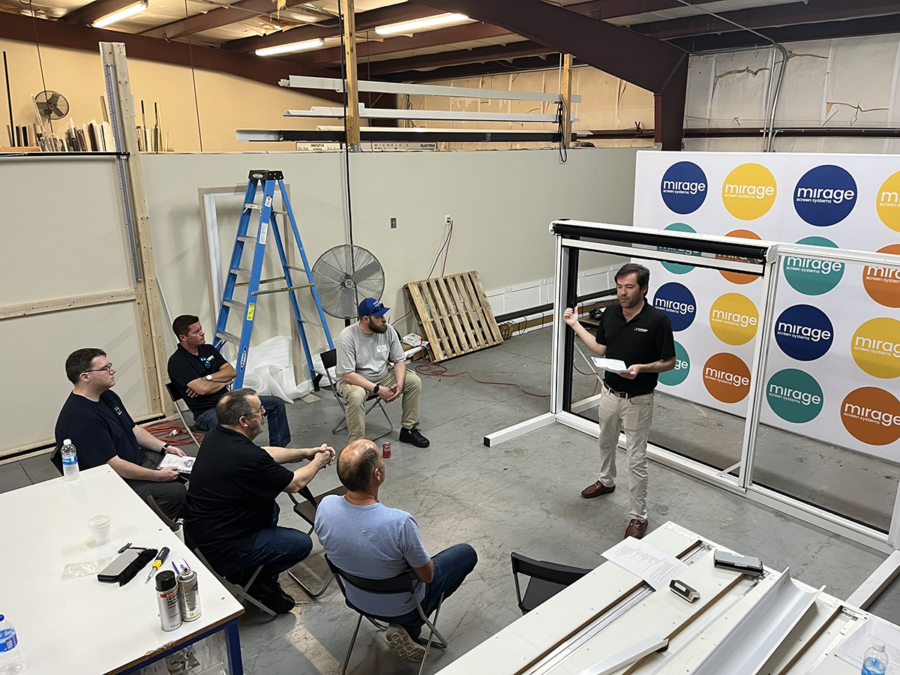
Why choose Mirage?
Our Products
Our service and support
Quality Materials, North American made
The Smoothest Operating retractable screen door
Pivot pro handle
One visit install
3 products:
- 1750
- 3500
- H4800
Quality customer service
Training support
Easy shipping
Webstore
Marketing support
Competitive pricing

Slide 10
Product – Quality Materials
Sturdy aluminum – Vancouver
Quality mesh – Phifer (Alabama)
Durable plastics – aeon (Vancouver)
Assembled in North America
Mirage team in Vancouver
Planned: Also in Florida

Slide 11
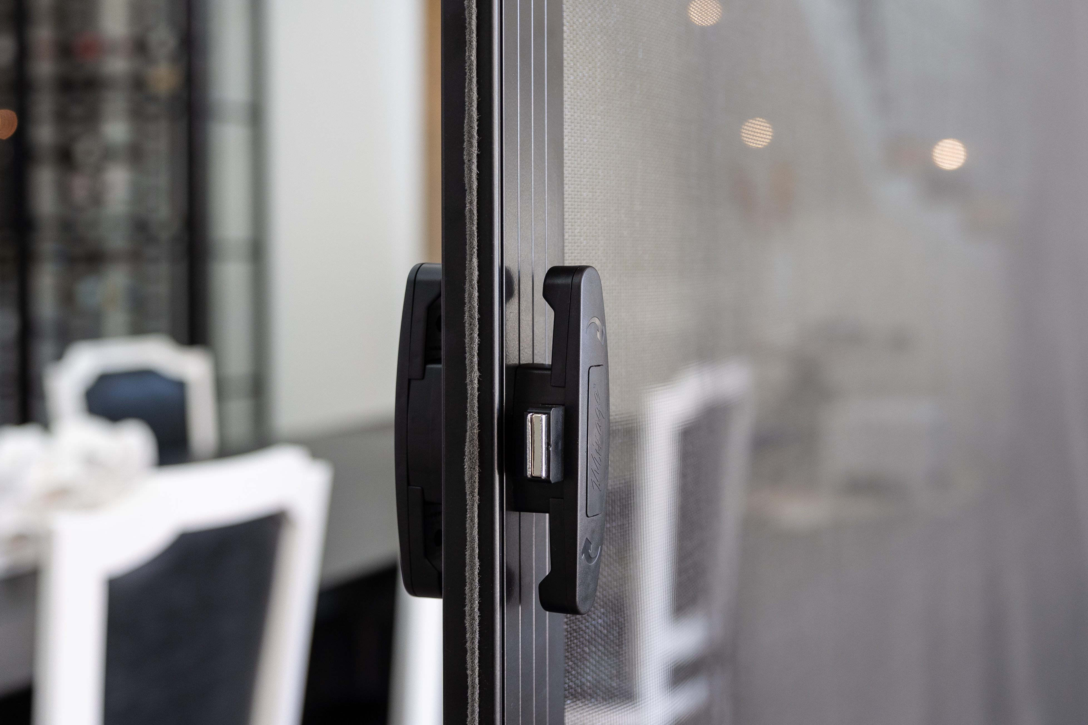
Product – Smooth operating
Pull bar guides – Larger, and with Teflon
Brass bushing in housing cap – Smoother retraction
Pivot pro handle – Smooth release

Slide 12
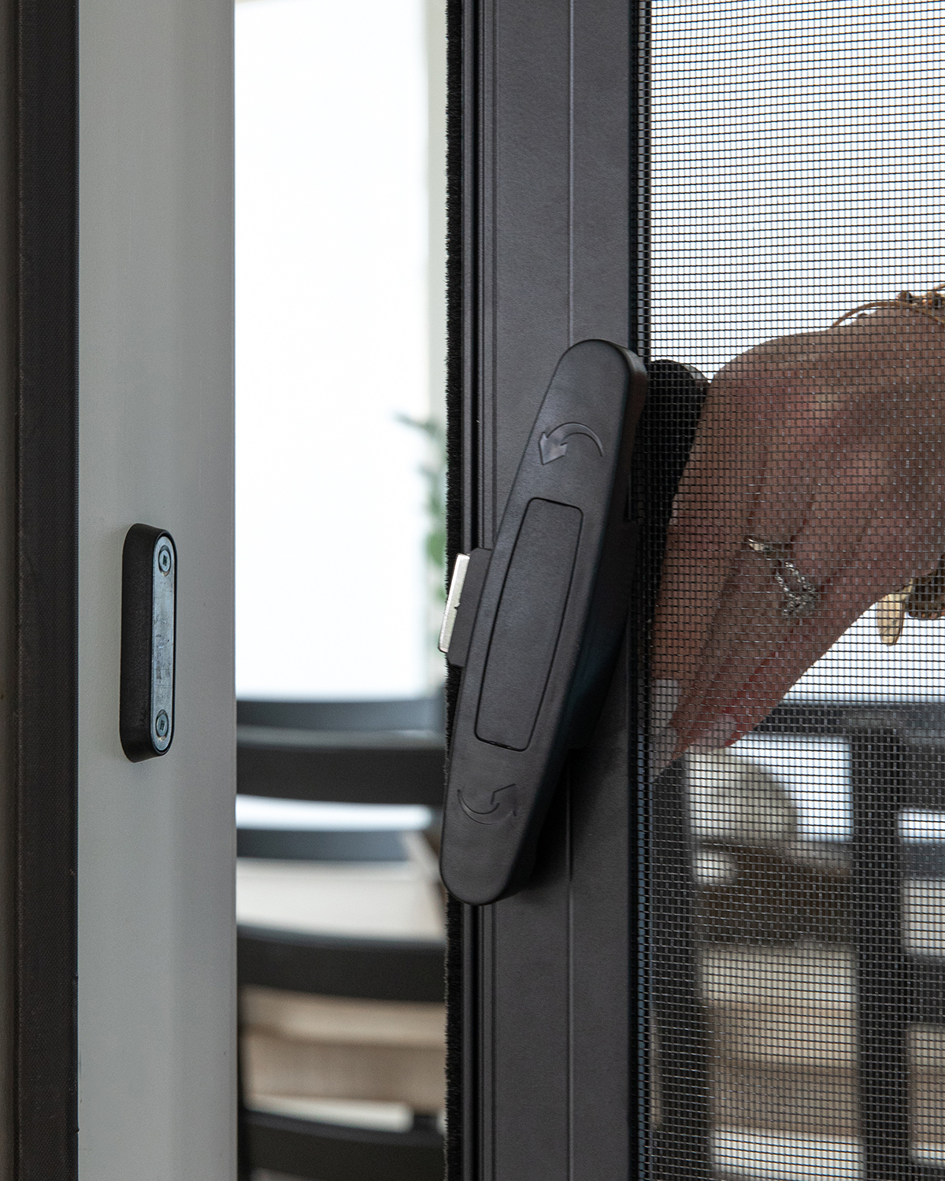
Product – Pivot pro handle
A better customer experience
Jig for easy installation
Released in 2018, now 30% of sales
Available in the eight standard colors

Slide 13
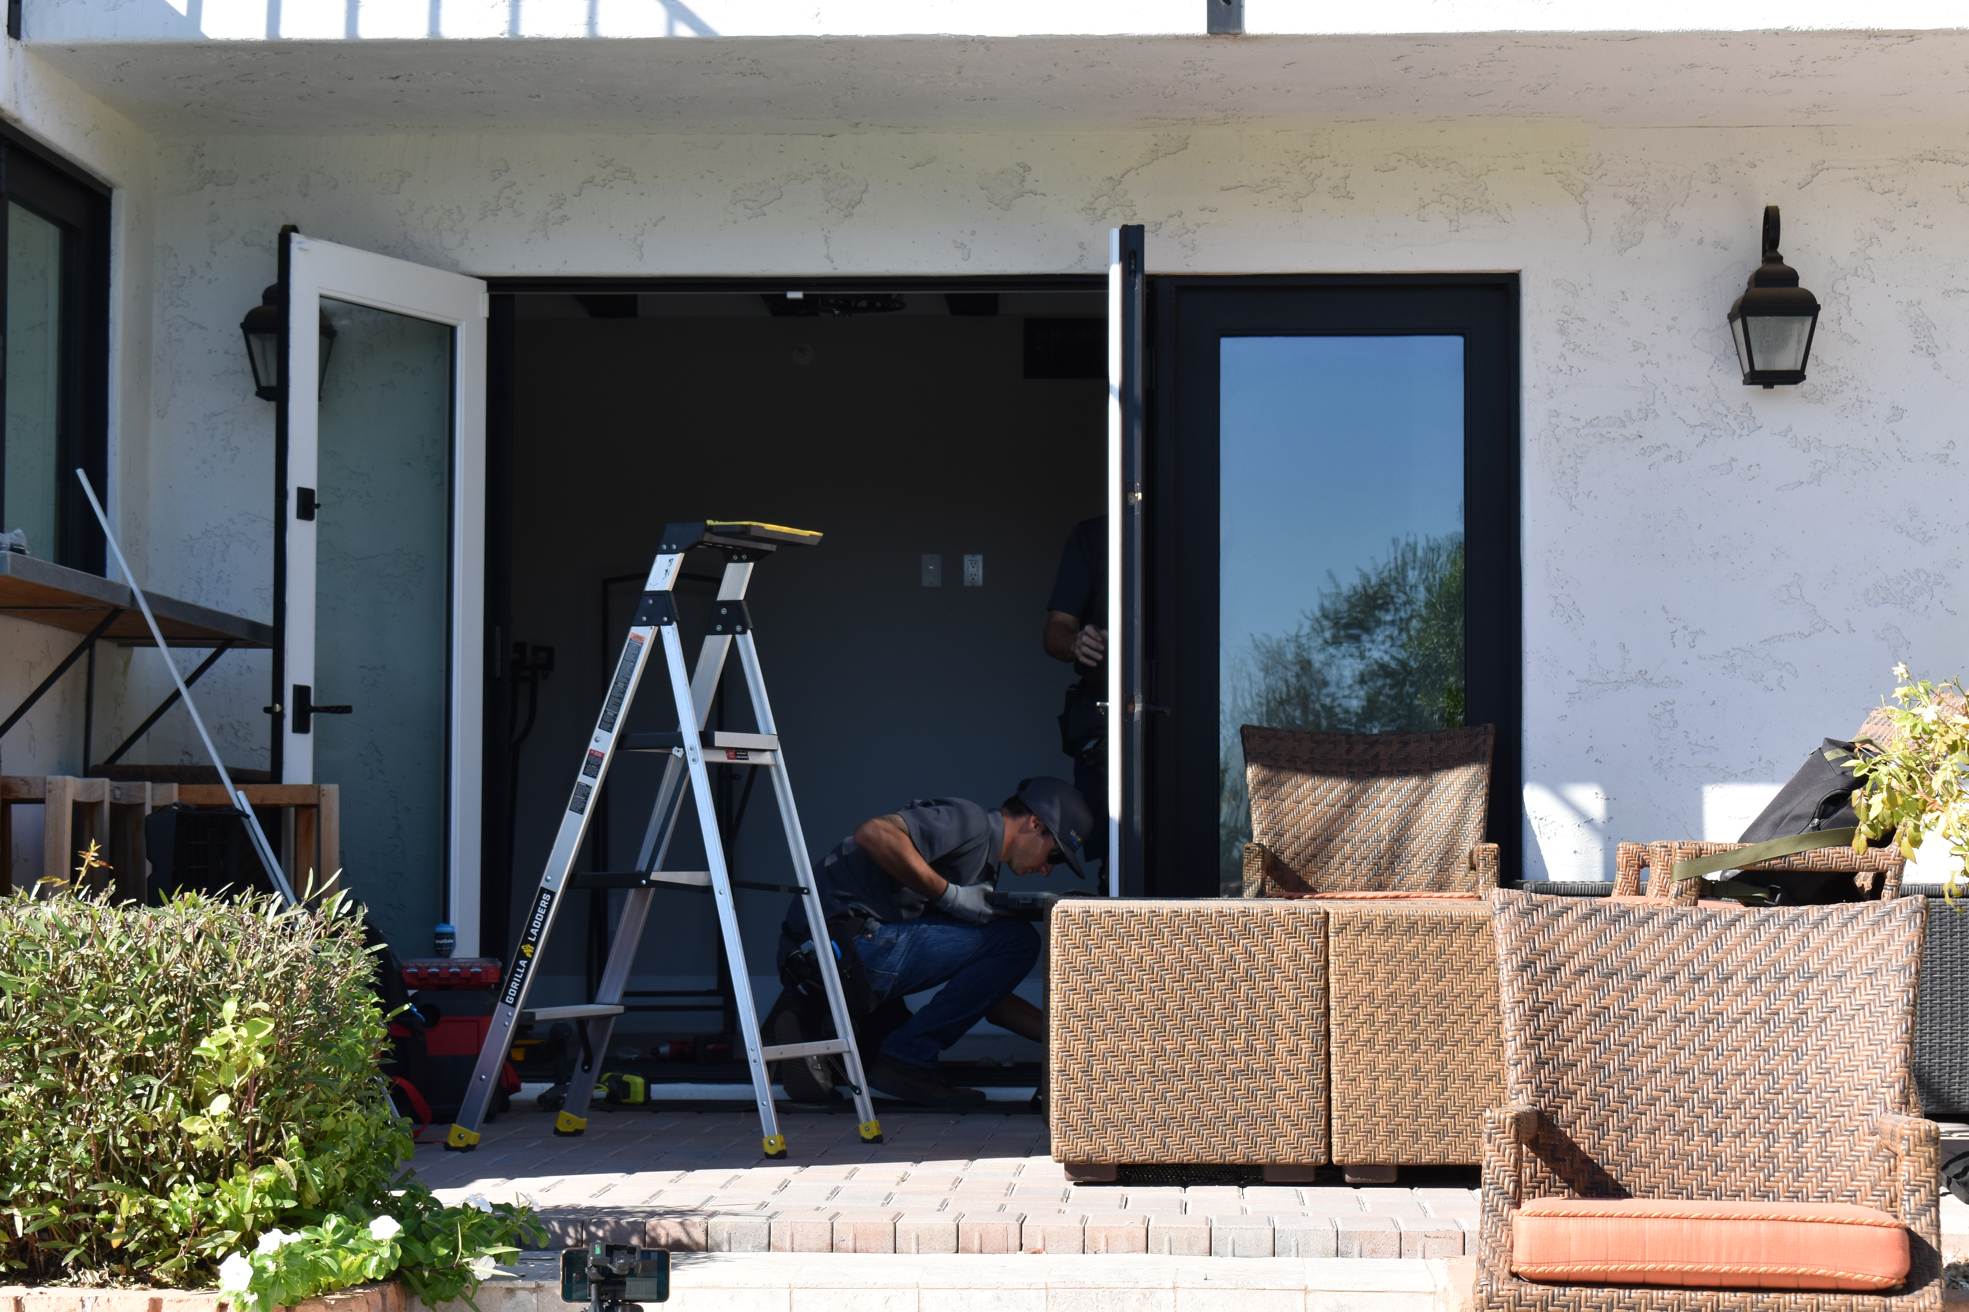
Product – One-visit install
The Mirage screen is designed to be cut to size on site – quickly & efficiently
This one stop approach saves you time & Money
Less travel time = greater revenue per hour
The customer isn’t waiting around for you to show up – twice!

Slide 14
The Numbers
Dealer cost of a standard unit = $170​
Profit margin per unit​
Sales price = $425 - $475 $450​
Landed cost = $180 - $210 $200​
Gross profit $ = $215 - $295
Gross profit % = 45% - 55%

Slide 15
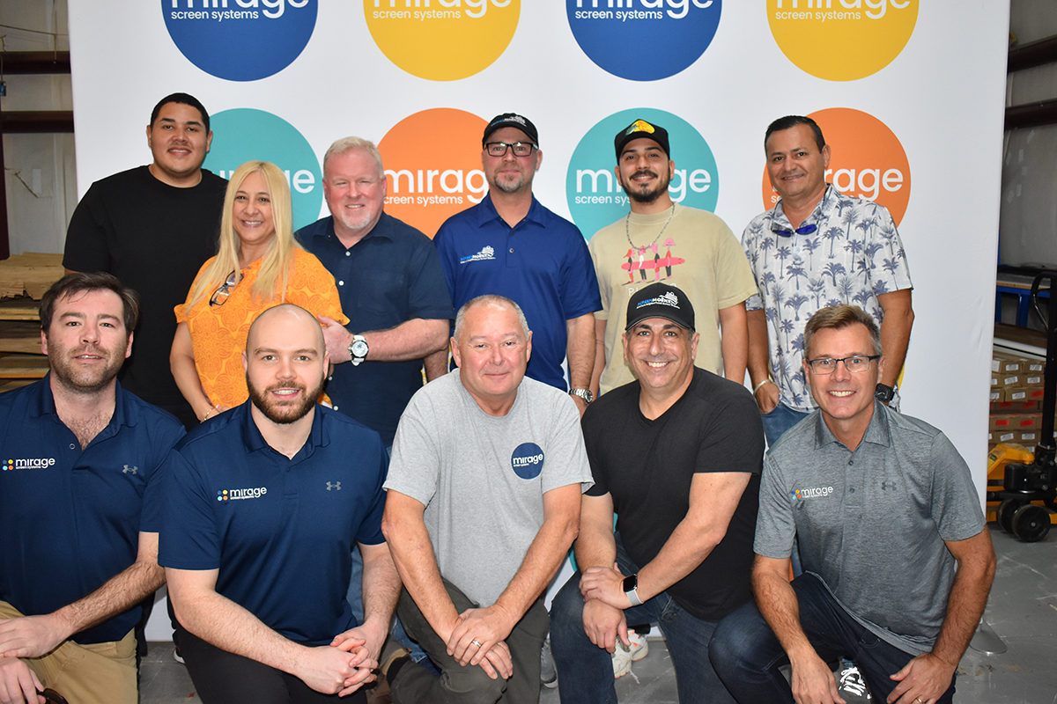
Recap:​ What is in it for you?
Good profit margins​
Low maintenance, well supported product​
Diversification your product offering

Slide 16
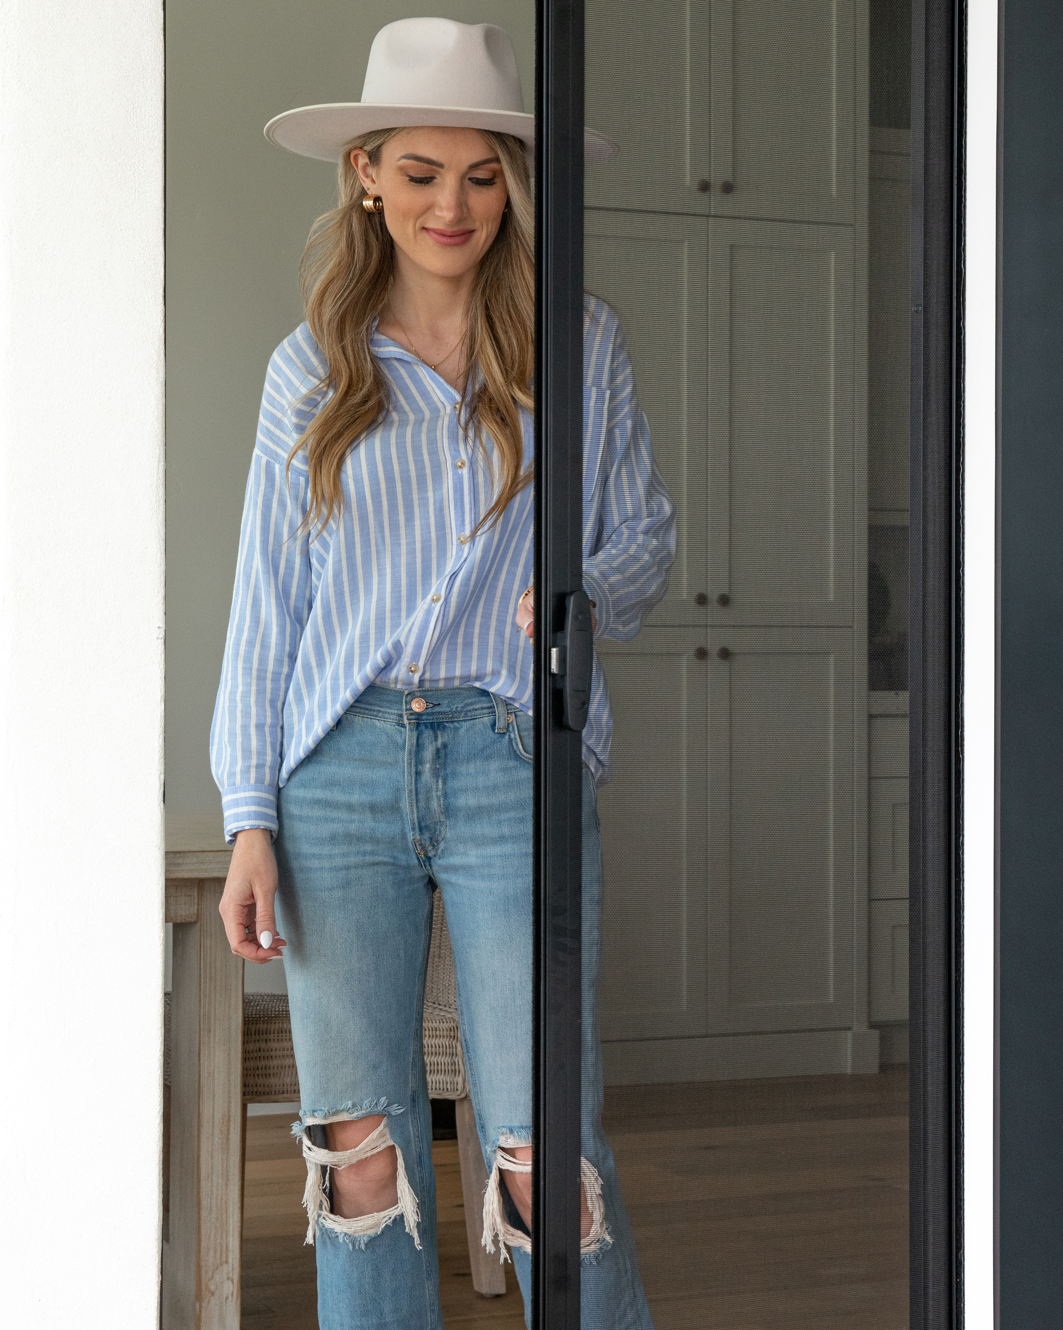
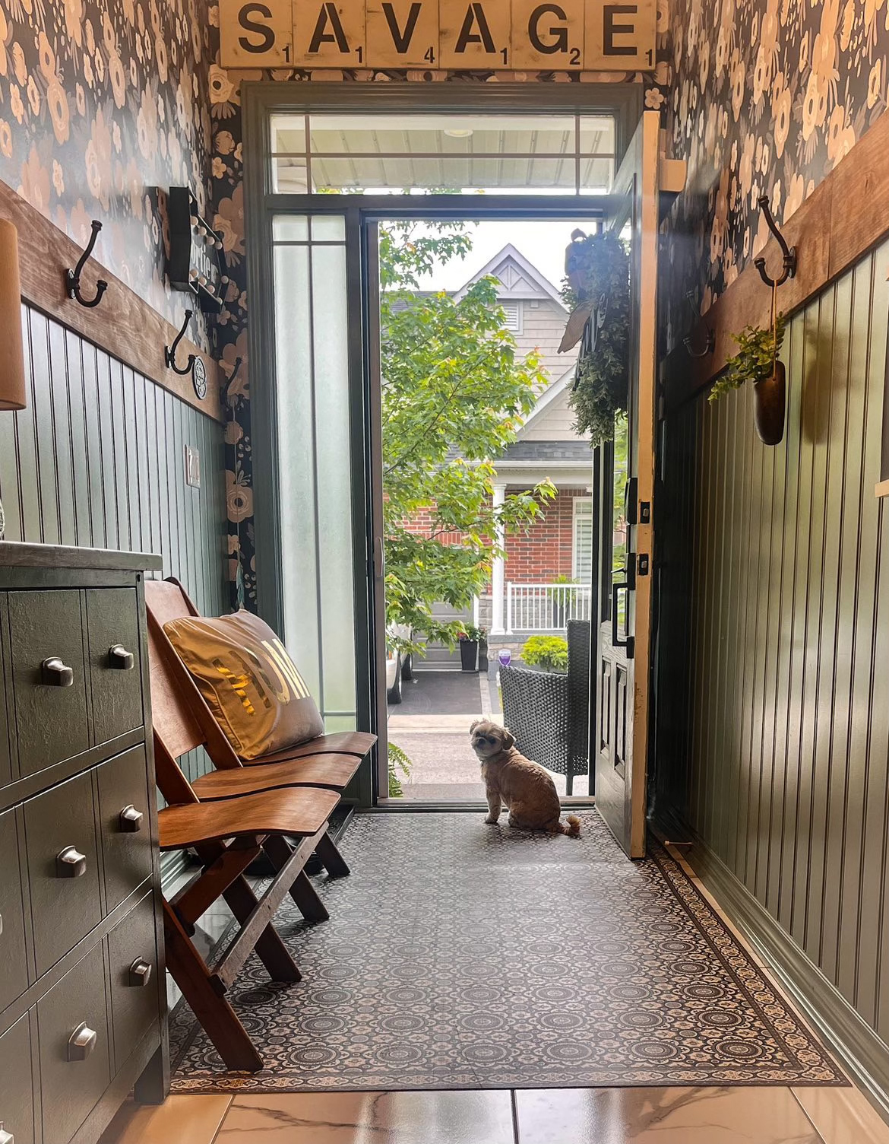
Questions??

